Slide 1

Past Simple
Прошедшее простое время

Slide 2
Past Simple
Прошедшее простое время

Slide 3

Образование
Past Simple
V + -
ed
V2

Slide 4


Глагол to be
в Past Simple
I
You
He/ she/ it
Was
We
You
They
Were

Slide 5
Past Simple ic – әрекеттің бұрын болып қойғандығын және іс – әрекеттің болғандығына бәраз уақыт өткендігін білдіреді.
Время Past Simple используется для обозначения действия, которое произошло в определенное время в прошлом и время совершения которого уже истекло.

Slide 6

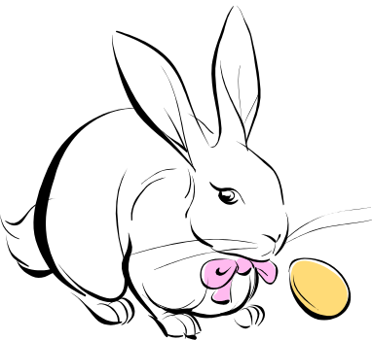
Указатели времени в Past Simple
Yesterday- Вчера
Last week- На прошлой неделе
Last month- В прошлом месяце
Last year- В прошлом году
… years ago…- … лет назад

Slide 7

Утвердительное предложение:
I played We played
You played You played
He / she / it played They played
Отрицательное предложение:
I didn’t play We didn’t play
You didn’t play You didn’t play
He / she / it didn’t play They didn’t play

Slide 8

Общий вопрос:
Did Misha see my friend last month?
Yes, he did.
Альтернативный вопрос:
Did Misha see my friend last month
or last week?

Slide 9

Вопрос к подлежащему:
Who saw my friend last month?
Misha did.
Специальный вопрос:
When did Misha see my friend?
Whose friend did Misha see?

Slide 10



Разделительный вопрос:
-Misha saw my friend last month,
didn`t he?
-Yes, he did.
-Misha didn`t see my friend last month,
did he?
-Yes, he did.

Slide 11
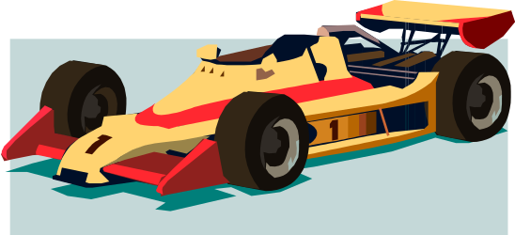
You home task:
Ask all kinds of questions:
She was in Moscow last month.
They watched an interesting film.
We bought a present for our
Granny yesterday.

